Slide 1
statistics
For first stage
prepared by
Aseel Ali

Slide 2
Sample Space
The set of all possible outcomes of an experiment is called the sample space. We will denote the outcomes by O1, O2, . . . , and the sample space by S. Thus, in set-theory notation, S = {O1, O2,. ..}
Events
An individual outcome in the sample space is called a simple event, while. . . An event is a collection or set of one or more simple events in a sample space.

Slide 3
Example:
Roll of a Die S = {1, 2, · · · , 6} Simple Simple Event: The outcome “3”.
Event: The outcome is an even number (one of 2, 4, 6)
Event: The outcome is a low number (one of 1, 2, 3)

Slide 4
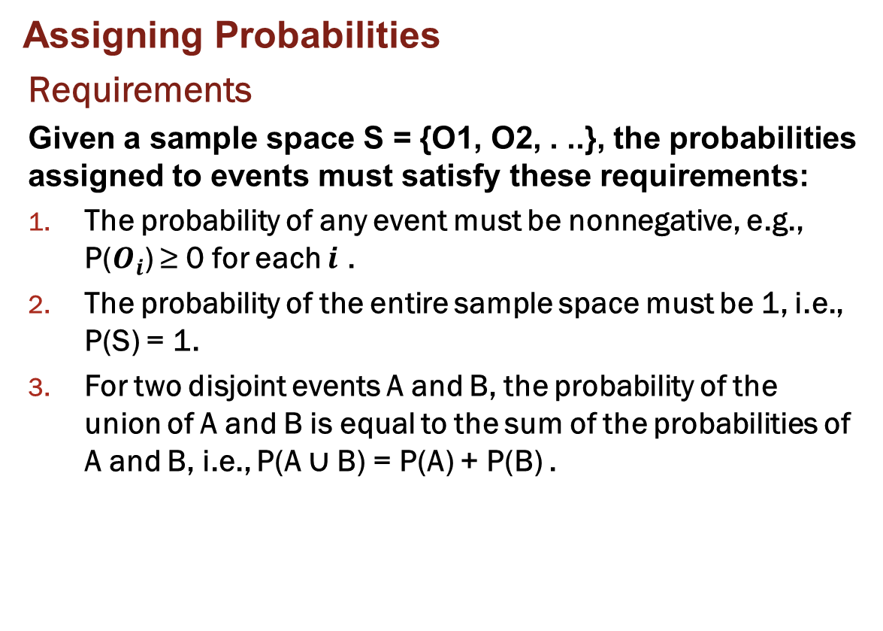
Assigning Probabilities
Requirements
Given a sample space S = {O1, O2, . ..}, the probabilities assigned to events must satisfy these requirements:
The probability of any event must be nonnegative, e.g., P($O_{i}$) ≥ 0 for each $i$ .
The probability of the entire sample space must be 1, i.e., P(S) = 1.
For two disjoint events A and B, the probability of the union of A and B is equal to the sum of the probabilities of A and B, i.e., P(A ∪ B) = P(A) + P(B) .

Slide 5
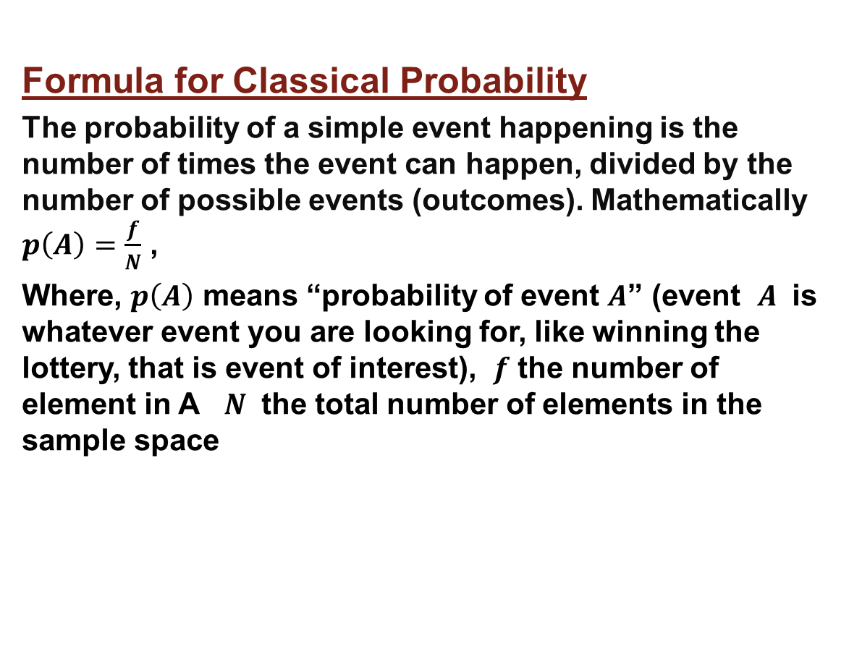
Formula for Classical Probability
The probability of a simple event happening is the number of times the event can happen, divided by the number of possible events (outcomes). Mathematically $p\left(A\right)=\frac{f}{N}$ ,
Where, $p\left(A\right)$ means “probability of event $A$” (event $A$ is whatever event you are looking for, like winning the lottery, that is event of interest), $f$ the number of element in A $N$ the total number of elements in the sample space

Slide 6
Rolling One Die
Suppose our statistical experiment
involves rolling one die. Since the die has 6 sides, there are six possible outcomes in the sample space. We can write the sample space as the set 1,2,3,4,5,6. We can also create a probability distribution, which is basically a frequency distribution with the frequency column replaced by a column of probabilities. For rolling one die, the frequency distribution is:

Slide 7
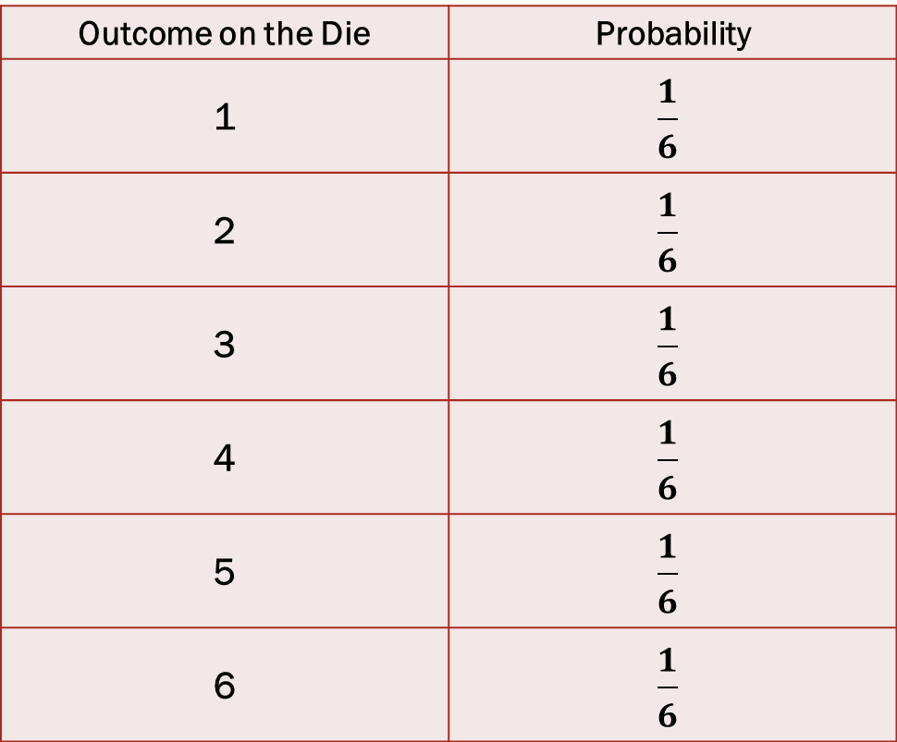
Outcome on the Die | Probability
1 | $$\frac{1}{6}$$
2 | $$\frac{1}{6}$$
3 | $$\frac{1}{6}$$
4 | $$\frac{1}{6}$$
5 | $$\frac{1}{6}$$
6 | $$\frac{1}{6}$$

Slide 8
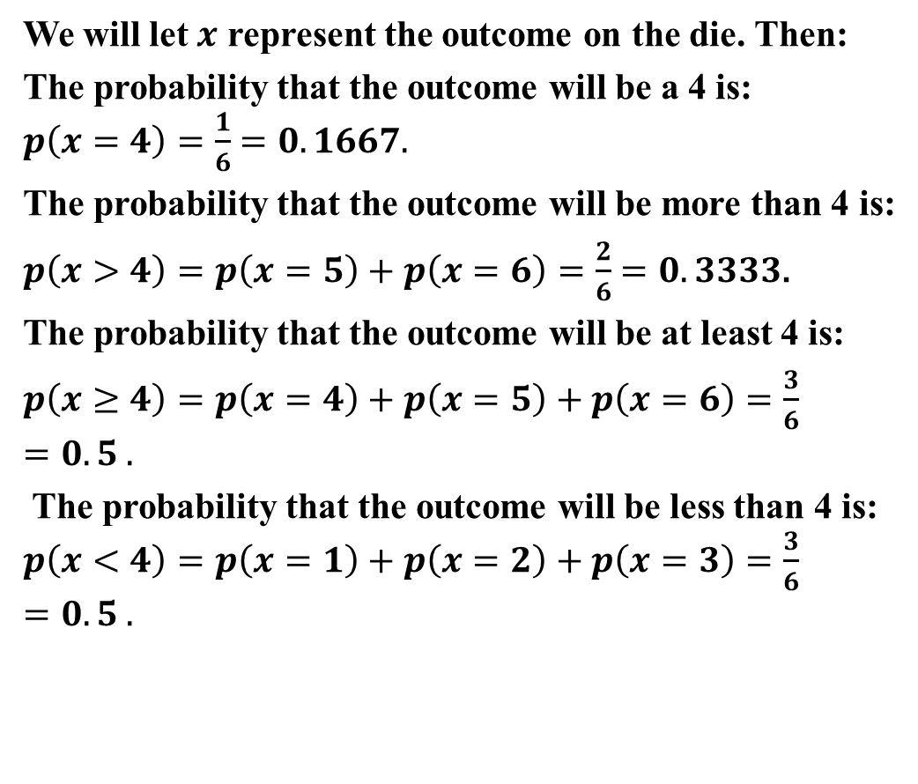
We will let $x$ represent the outcome on the die. Then:
The probability that the outcome will be a 4 is:
$p\left(x=4\right)=\frac{1}{6}$ $=0.1667.$
The probability that the outcome will be more than 4 is:
$p\left(x>4\right)=p\left(x=5\right)+p\left(x=6\right)=\frac{2}{6}$ $=0.3333$.
The probability that the outcome will be at least 4 is:
$p\left(x≥4\right)=p\left(x=4\right)+p\left(x=5\right)+p\left(x=6\right)=\frac{3}{6}$ $=0.5 .$
The probability that the outcome will be less than 4 is: $p\left(x<4\right)=p\left(x=1\right)+p\left(x=2\right)+p\left(x=3\right)=\frac{3}{6}=0.5 .$

Slide 9
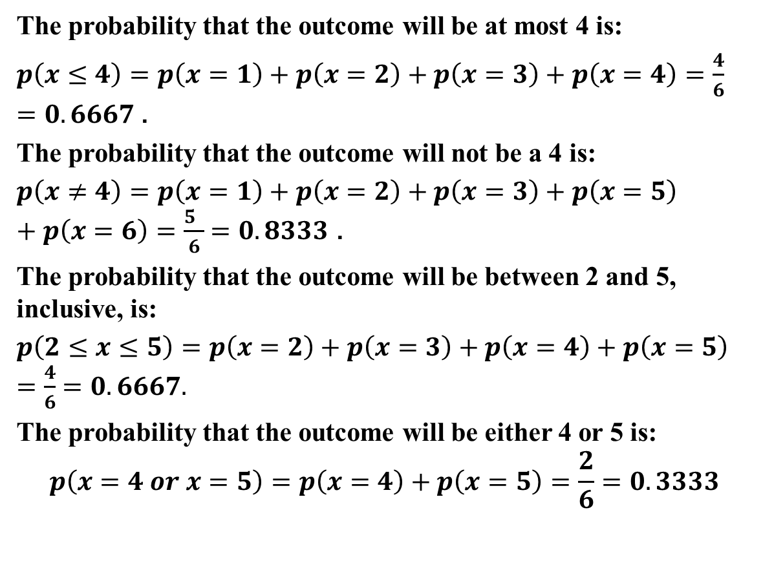
The probability that the outcome will be at most 4 is:
$p\left(x≤4\right)=p\left(x=1\right)+p\left(x=2\right)+p\left(x=3\right)+p\left(x=4\right)=\frac{4}{6}$ $=0.6667$ .
The probability that the outcome will not be a 4 is:
$p\left(x≠4\right)=p\left(x=1\right)+p\left(x=2\right)+p\left(x=3\right)+p\left(x=5\right)+p\left(x=6\right)=\frac{5 }{6}$ $=0.8333$ .
The probability that the outcome will be between 2 and 5, inclusive, is:
$p\left(2≤x≤5\right)=p\left(x=2\right)+p\left(x=3\right)+p\left(x=4\right)+p\left(x=5\right)=\frac{4}{6}$ $=0.6667.$
The probability that the outcome will be either 4 or 5 is:
$$p\left(x=4 or x=5\right)=p\left(x=4\right)+p\left(x=5\right)=\frac{2}{6}=0.3333$$

Slide 10
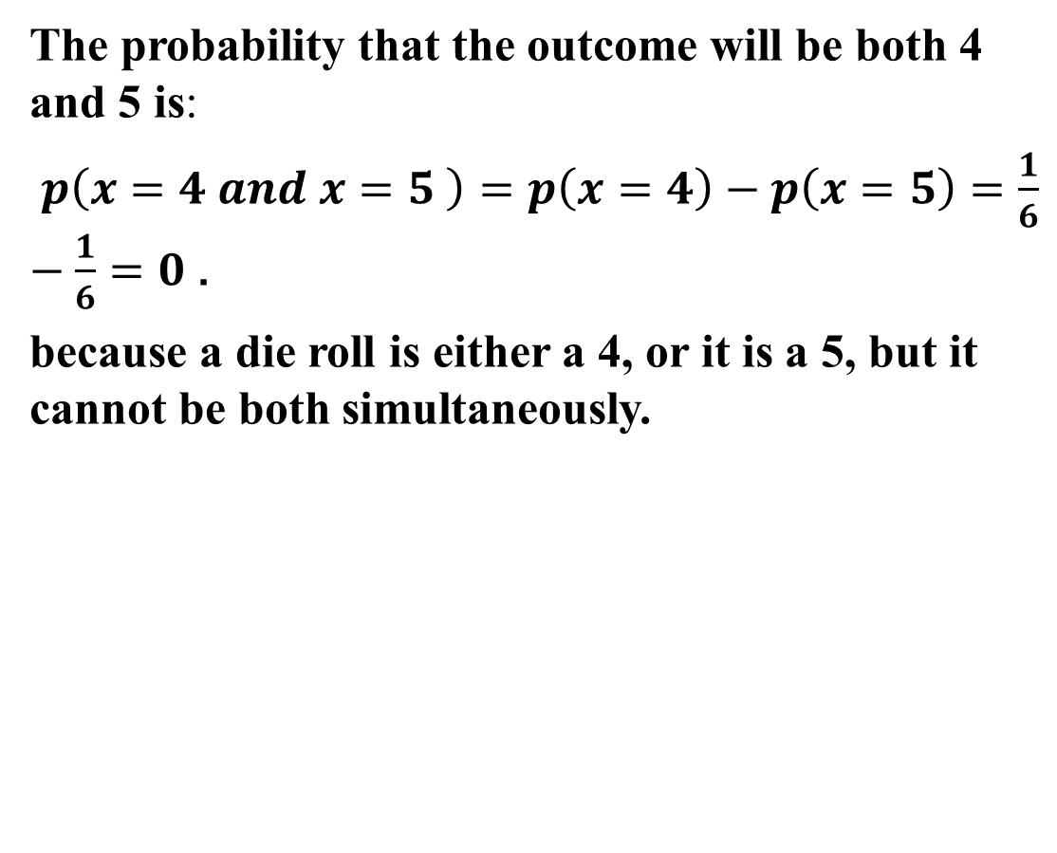
The probability that the outcome will be both 4 and 5 is:
$p\left(x=4 and x=5 \right)=p\left(x=4\right)−p\left(x=5\right)=\frac{1}{6}−\frac{1}{6}=0$ .
because a die roll is either a 4, or it is a 5, but it cannot be both simultaneously.

Slide 11
Rolling Two Dice
Suppose we now roll two dice. The outcomes of this experiment depend on the two separate outcomes of each die, so there are two independent variables. We can display the 36 outcomes in a table.
(1,1) | (1,2) | (1,3) | (1,4) | (1,5) | (1,6)
(2,1) | (2,2) | (2,3) | (2,4) | (2,5) | (2,6)
(3,1) | (3,2) | (3,3) | (3,4) | (3,5) | (3,6)
(4,1) | (4,2) | (4,3) | (4,4) | (4,5) | (4,6)
(5,1) | (5,2) | (5,3) | (5,4) | (5,5) | (5,6)
(6,1) | (6,2) | (6,3) | (6,4) | (6,5) | (6,6)

Slide 12
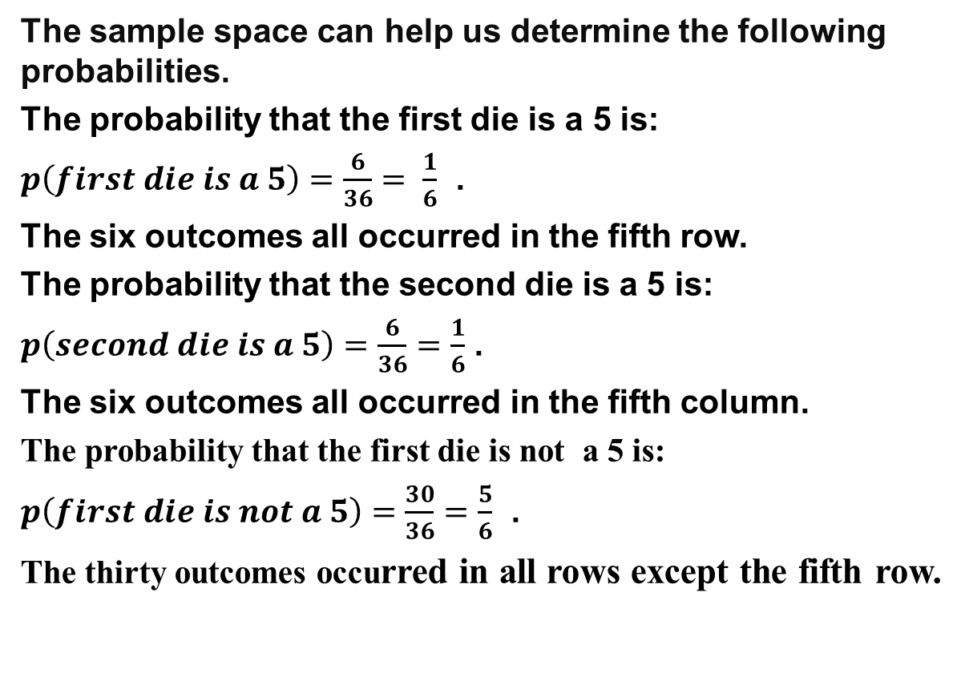
The sample space can help us determine the following probabilities.
The probability that the first die is a 5 is:
$p\left(first die is a 5\right)=\frac{6}{36}$ $= \frac{1}{6}$ .
The six outcomes all occurred in the fifth row.
The probability that the second die is a 5 is:
$p\left(second die is a 5\right)=\frac{6}{36}=\frac{1}{6}$ .
The six outcomes all occurred in the fifth column.
The probability that the first die is not a 5 is:
$p\left(first die is not a 5\right)=\frac{30}{36}=\frac{5}{6}$ .
The thirty outcomes occurred in all rows except the fifth row.

Slide 13
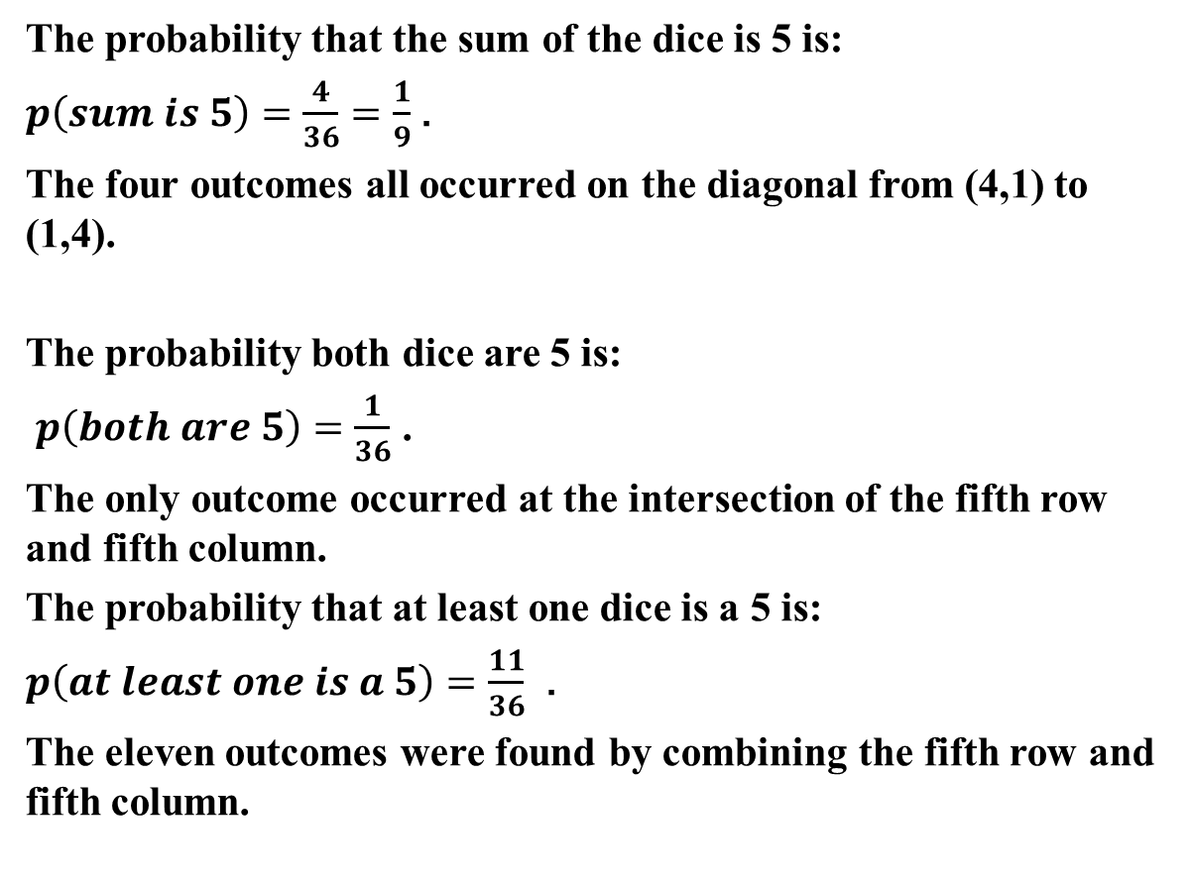
The probability that the sum of the dice is 5 is:
$p\left(sum is 5\right)=\frac{4}{36}=\frac{1}{9}$ .
The four outcomes all occurred on the diagonal from (4,1) to (1,4).
The probability both dice are 5 is:
$p\left(both are 5\right)=\frac{1}{36}$ .
The only outcome occurred at the intersection of the fifth row and fifth column.
The probability that at least one dice is a 5 is:
$p\left(at least one is a 5\right)=\frac{11}{36}$ .
The eleven outcomes were found by combining the fifth row and fifth column.

Slide 14

The probability that neither dice is a 5 is:
$p\left(neither is a 5\right)=\frac{25}{36}$ .
The 25 outcomes were found every where but the fifth row or fifth column.

